Slide 1

The ReShare Hub
Share What You Don't Need, Receive What You Deserve
A community-driven platform for sharing and reusing pre-loved items 🌍💚

Slide 2
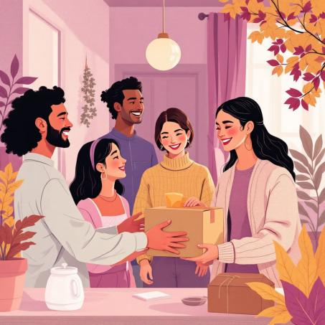
Welcome to a Kinder Way of Sharing
What We Do
Free community platform connecting neighbors to share, donate, and exchange unused items nearby
🌱 Sustainability first — reducing waste through reuse
💚 Kindness in action — helping those who need it most
Every item deserves a second life!

Slide 3

The Challenge We're Solving
Growing Waste Crisis
Missing Connections
Millions of usable items discarded from homes annually
No easy way to share goods with neighbors who need them
Affordability Gap
People struggling to afford essentials available nearby for free

Slide 4
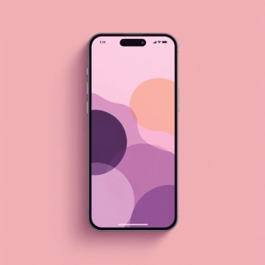
Our Solution: The ReShare Hub
Simple. Local. Impactful.
Web platform connecting givers and receivers
Encourages donation, exchange & reuse
Builds local networks of generosity
Promotes sustainable living
Making sharing as easy as a few clicks 💚

Slide 5
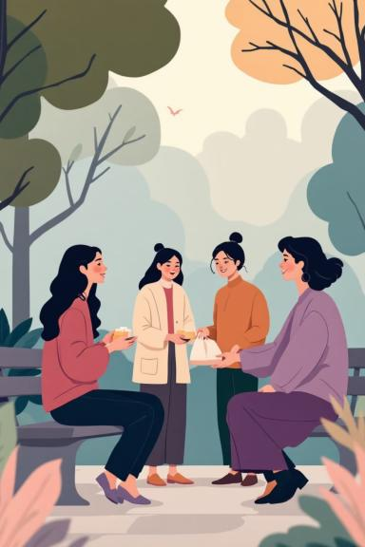
How The ReShare Hub Works
01
02
Post Your Items
Browse Local Listings
Upload photos and descriptions of things you want to give away 📸
Discover useful items others have shared near you 📍
03
Connect & Share
Chat securely, arrange safe meetups, and exchange items 💬

Slide 6

Platform Features
Easy Posting
Smart Search
Quick photo uploads and simple item descriptions make listing effortless
Location-based browsing finds items available in your neighborhood
Secure Chat
Community-Driven
Built-in messaging keeps conversations safe and organized
100% free platform powered by generosity and shared values

Slide 7

Why Choose ReShare?
♻️ Environmental Impact
Reduce waste, lower carbon footprint, promote circular economy
🤝 Help Your Neighbors
Provide essentials to those who need them most in your community
😊 Declutter with Purpose
Make space at home while knowing your items find new life
❤️ Build Community Bonds
Connect with like-minded neighbors who share your values

Slide 8




What You Can Share
Everyday Essentials
Electronics & More
Special Categories
👕 Clothing & accessories
🔌 Working electronics
🌿 Garden tools & plants
📚 Books & magazines
🧸 Kids' toys & gear
🎨 Art & craft supplies
🪑 Furniture & home items
🍳 Kitchen appliances
🏃 Sports equipment

Slide 9




Built with Innovation
AI-Powered Design
Mobile-Friendly
Secure Backend
Created using Lovable.ai — cutting-edge no-code platform
Responsive design works perfectly on any device
Cloud storage and secure authentication built-in
Design Philosophy: Green pastel theme with smooth animations, minimal interface, and intuitive navigation for all ages

Slide 10



Join The Movement Today
Our Impact Goals
🌍 Encourage reuse over buying new
♻️ Build circular economy awareness
🤝 Create lasting local connections
🌱 Foster sustainable daily habits
Coming Soon
📱 Mobile app launch
🏆 Reward points for active sharers
🎓 Partnerships with schools & NGOs
"Because sharing is caring, and every small action creates ripples of positive change"

